Slide 1
Personalized Travel destinations
Submitted to the Coursera Capstone Project IBM Data Science Specialization

Slide 2
Project Goals
Can we predict new, attractive travel destinations based on a client’s history and a database of destination info?
This is the business generating question
Can we make this work using a test case before we spend more money?
Practical application question

Slide 3
Data Sources
FourSquare: a major venue data provider with well established, searchable, international data.
Requires some engineering
Climate, topography, population, etc.:
Destination characteristics other than venues

Slide 4
Methods
Reduce Dimensions: consolidate all the information into the most useful content.
Cluster Analysis: find groups that are similar in ways that enable novel recommendations
Details are explained in the report.

Slide 5
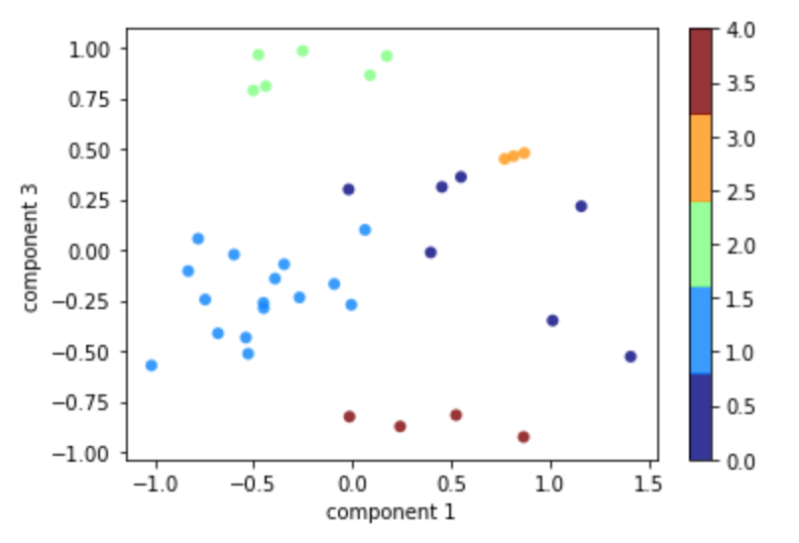
Results
This graphic shows a slice through the resulting clusters in a way that contrasts climate and cultural differences.
How does this look on
Maps?
0
3
Climate Difference
1
2
4
Cultural Difference

Slide 6
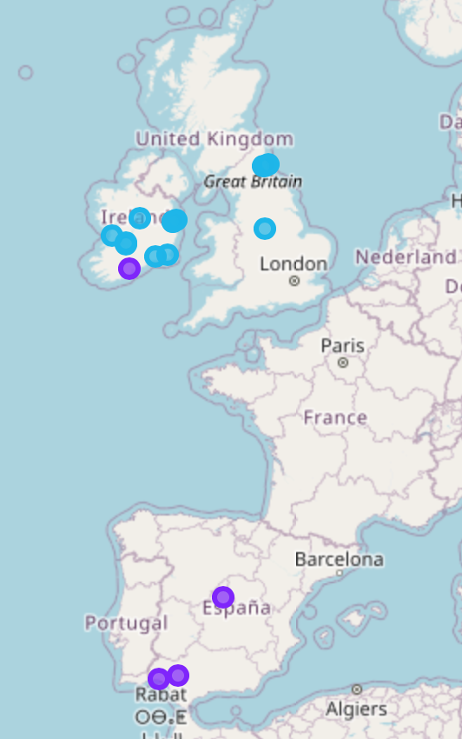
Europe
Group 2: dominated by Irish and English culture.
Group 1:dominated by Spanish culture
The anomaly is Cork in Ireland. Might be of interest to a client who enjoyed Spain.
Labels
1 2

Slide 7
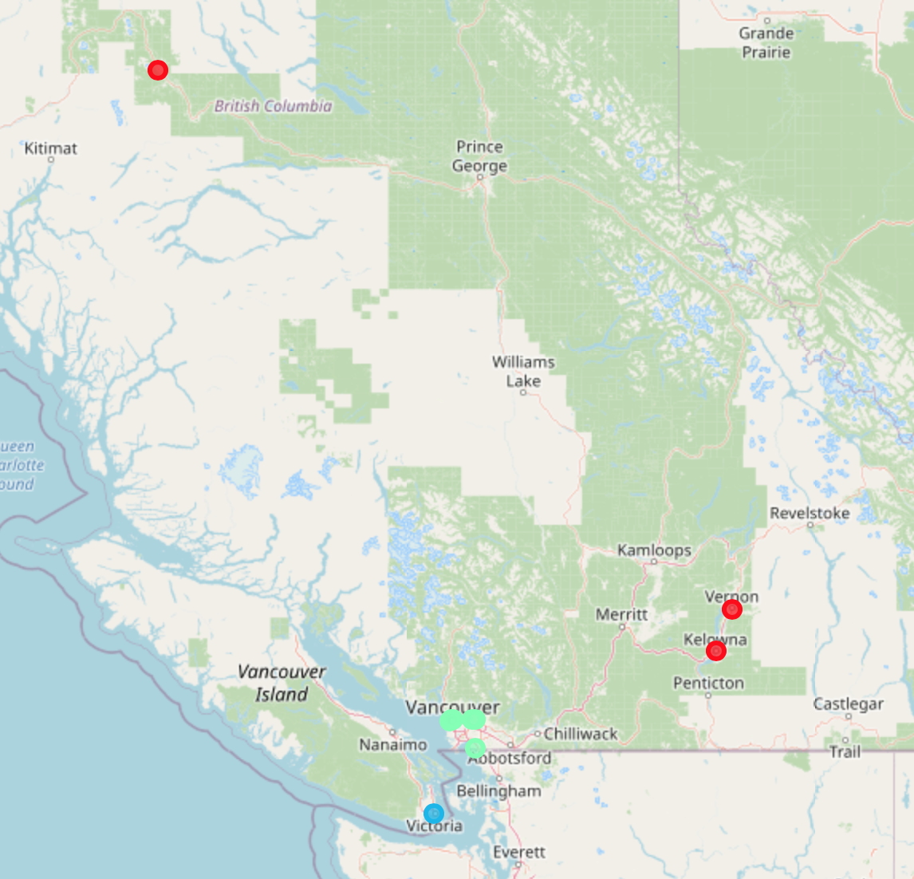
Canada
Group 0: Vancouver
Group 4: Canadian inland
The anomaly is Victoria. Unexpected connection to Irish and English locations but with obvious differences.
(mostly coastal, mixed culture)
(mostly coastal, mixed culture)
Labels
0 2 4

Slide 8
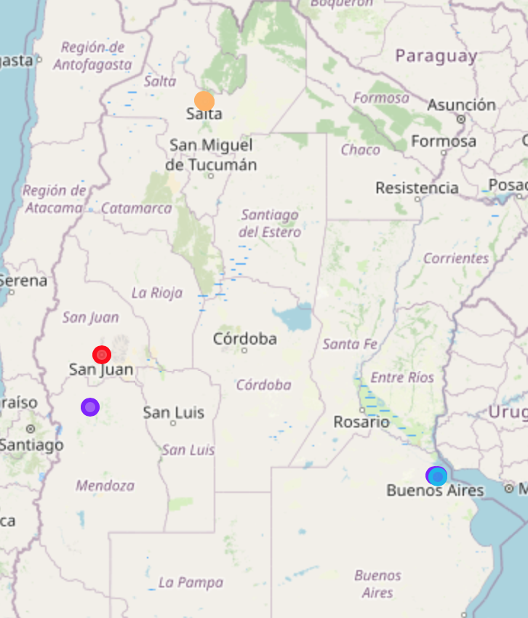
Argentina
Group 3: Salta only, but similar to other Spanish cultural locations (obviously).
Group 1: dominated by Spanish culture.
San Juan is a strangely Canadian anomaly.
The main anomaly is part of Buenos Aires being similar to Ireland or England!
Labels
1 2 3
4

Slide 9
Conclusions
The test succeeded in identifying anomalies – unexpected locations that could attract clients.
The methods are well known and should scale up to production scale.
Further testing is warranted.

Slide 10
What next?
Scale up data: both venue data and the geography data (climate, topography etc.)
Identify test clients and collect their data:
Find real clients innovative destinations.

